Slide 1

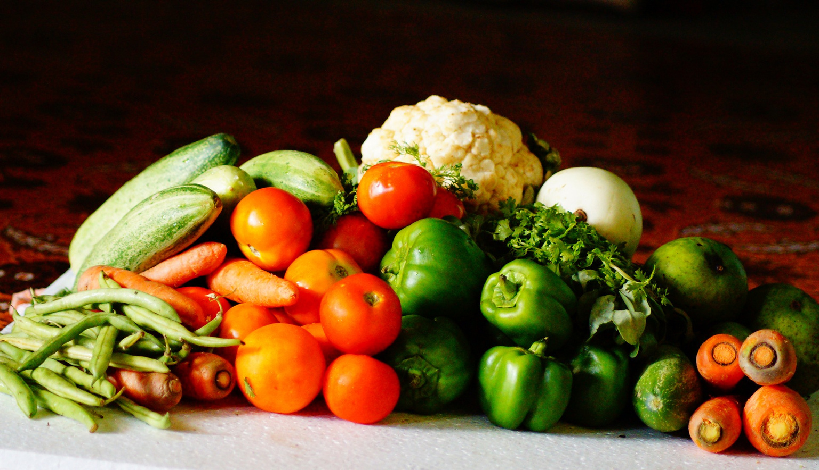
VEGETABLE
MARKET
ANALYSIS
Unearthing Insights into the Vegetable Market

Slide 2


It was a stroke of luck that I was assigned to work on this project, and I was able to create a compelling presentation on vegetable market analysis.
Shamsul Qumar
01

Slide 3

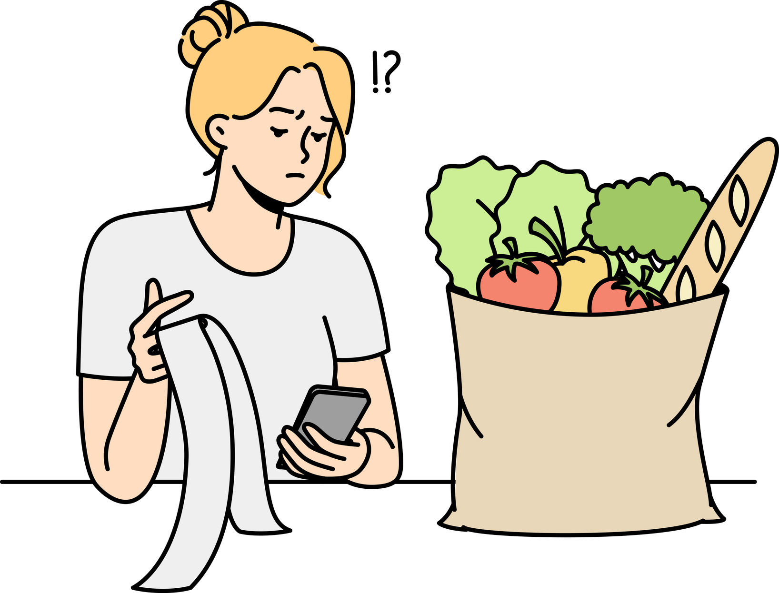
PROBLEM
100Rs KG?
Visiting the vegetable market multiple times sparked my curiosity about the fluctuating prices on a daily and weekly basis,
Why are we paying more in winters and less in summers for the same vegetables?
02

Slide 4

PROJECT
Web Scraping
PHASE I
We discovered that JSON data is in dictionary format and learned how to extract and convert it into a dataframe
03

Slide 5

PHASE II
Data Cleaning
The data was initially meaningful but required minor cleaning to prepare it for database creation in phase 3.
04

Slide 6

PHASE III
Creating Insights
05

Slide 7
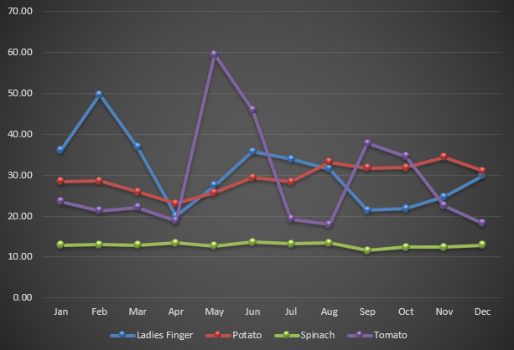
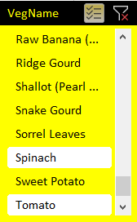
AVERAGE MONTHLY PRICE
Pivot table did the task and line graph helped
me to convey it better
I used slicer to choose the vegetable
06

Slide 8
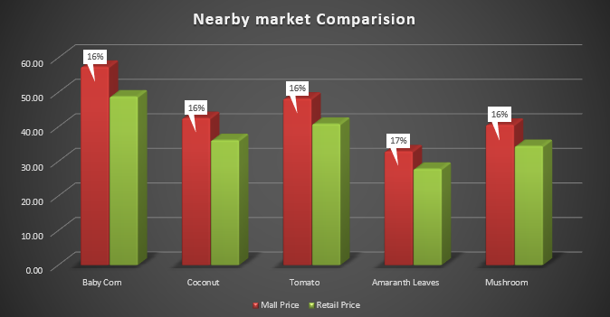
VEGETABLE PRICES IN NOIDA AND NEARBY MARKETS
Mall prices are 16% more compared to Retail Prices
Seasonal vegetables tend to be cheaper than non-seasonal ones.
Transportation costs, supply chain efficiency, competition, and demand can be the cause of this variation.
07

Slide 9
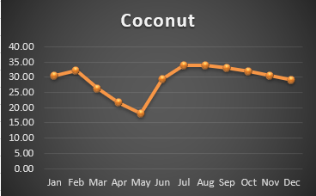
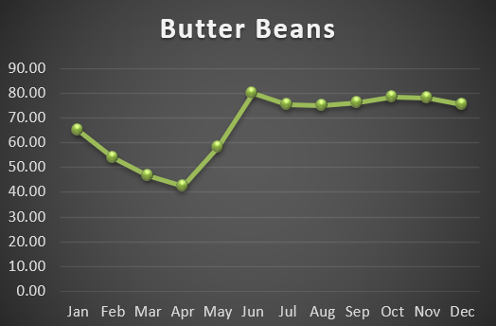

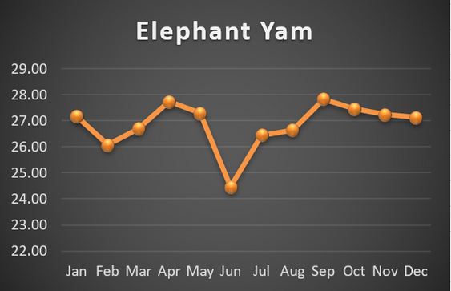
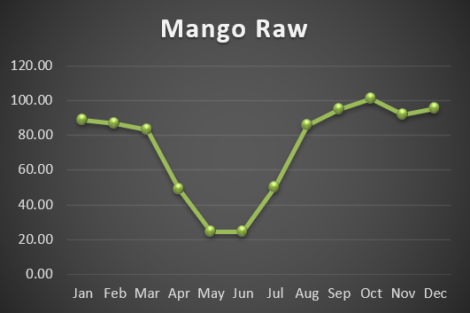

SEASONAL VEGETABLES OF NOIDA
Prices are dipping suddenly for a
season.
If the prices goes up suddenly for a seasons,
we can't consider them seasonal the price change can be because of some demand market.
08

Slide 10

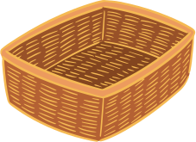


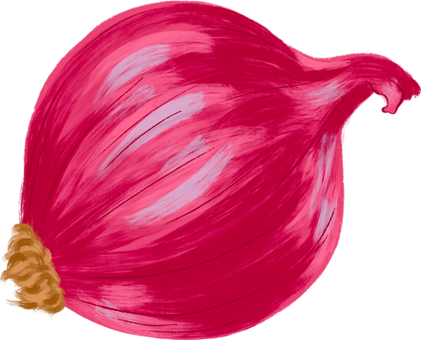


VEGEATABLE BASKET
FOR EACH INCOME
09

Slide 11

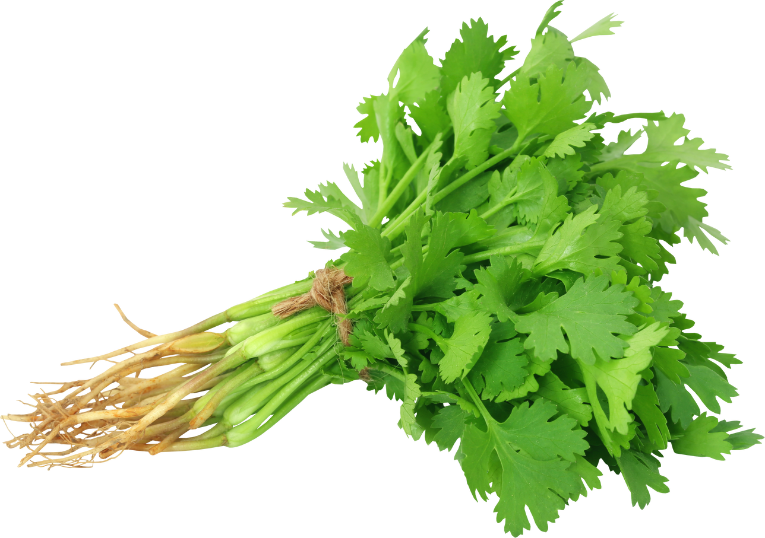








LOWER INCOME GROUP
₹2
₹145
₹38
Mostly Green Vegetables are
consumed by this group,
resulting in healthy lifestyle
₹23
₹20
₹26
₹44
₹300
Basket Cost = ₹ 300
app.
10

Slide 12


MIDDLE INCOME GROUP
₹2
₹182
₹63
Increased the quantity per person.
₹30
₹25
₹55
Added different seasonal vegetables.
₹73
₹431
Basket Cost = ₹ 430
app.
11

Slide 13

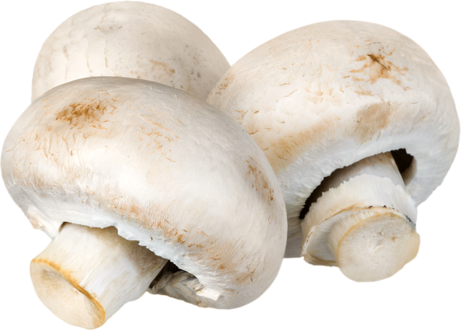
HIGH INCOME GROUP
₹38
₹290
₹88
₹130
This group usually creates a lot of extra
snacks and utilises extra garnishing
₹43
₹82
Some fancy vegetables are also added.
₹100
₹780
Basket Cost = ₹ 780
app.
12

Slide 14
PRICE CHANGE
As Seasonal Vegetables are changing over the year, our basket price will vary between 20 - 100 Rs according to the income groups.
As a considerable amount of people come from the lower income group so they will be more sensitive towards the price change.
One considerable price change in basket will be because of inflation rate over the period of time.
13

Slide 15
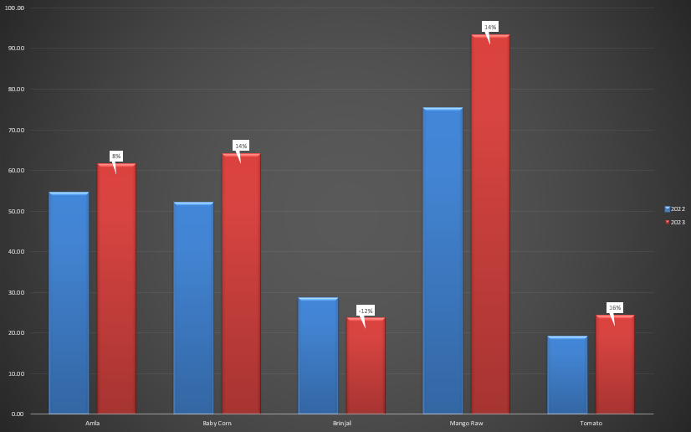
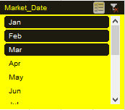
INFLATION RATE FOR EACH INCOME
As I have 3 months data,
so considering winter Season only
Prices are deflating also,
so there are more factors on which prices
can vary.
14

Slide 16

FUTURE SCOPE
As we are creating vegetable basket for different income group,
we can further extend this basket creation for health conscious
people.
For those who burn a lot of calories need more calorie intake:
So they require vegetables for that need.
By integrating this data of nearby market we can tell the best suited vegetable according to the calculated needs of thier daily life and the maximum money they are willing to put in.
15

Slide 17
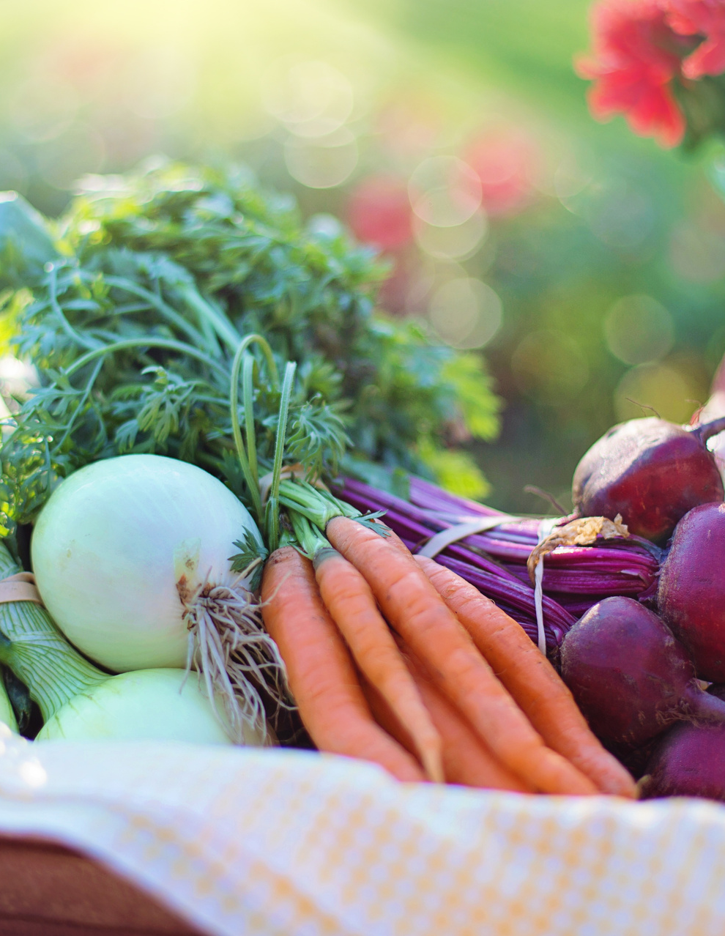
THANK YOU
Eat healthy as we
made it easy for you!
presentation by Shamsul Qumar

Slide 18



CASE STUDY
QUICK COMMERCE
VEGETABLE BUSINESS IN DELHI
01
presentation by Group 6B

Slide 19


MARKET SIZE AND POTENTIAL
FOR QUICK COMMERCE
Delhi with the 30 Cr of population,
where majority are youngsters came for work/study purpose.
30% of the population being youngsters, We can see a potential market of 9 crore customers for Quick commerce.
The online vegetable market in Delhi is currently worth around Rs. 500 crore
As the high demand for fresh vegetables and large customer base we can see a good scope of quick commerce in Delhi.
02
presentation by Group 6B

Slide 20
LOCAL MARKET VS QUICK COMMERCE
Local Market | Quick Commerce
Physically visit the market | More Convenient in terms of Ordering and Delivery
Affected by seasonal and weather-related changes in availability. | Steady and consistent supply of fresh vegetables
Lower Prices because of less middle man | Extra charges on convenience
Wider selection of prices as the stocks are from local farmers | Limited price selection because of small number of suppliers
02
presentation by Group 6B

Slide 21

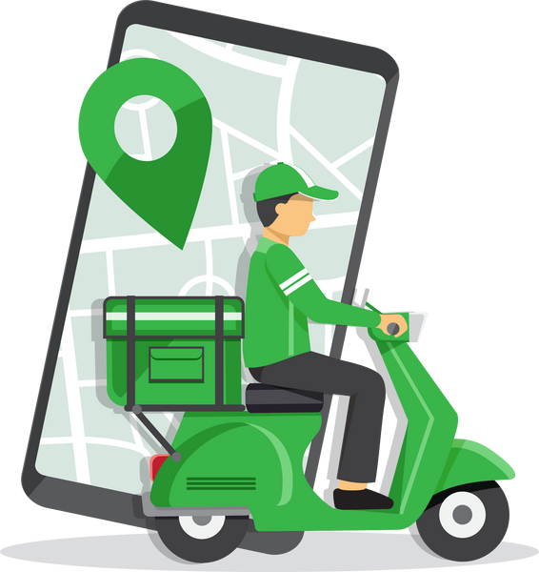




CHALLENGES FOR QUICK COMMERCE
Price Competition
Delivery
Logistics
Customer
Retention
Managing inventory
Quality control
02
presentation by Group 6B

Slide 22








COMPETITIVE LANDSCAPE IN MARKET
Presence
Delivery
Product
Pan India | Self Service | Vast Range
Selected | Crowd Sourced | Food and beverage
Selected | Crowd Sourced | Food and beverage
Selected | Self Service | Food and beverage
Pan India | Self Service | Vast Range
Big Basket
Dunzo
Blinkit
Fresh to
home
Pantry

Slide 23


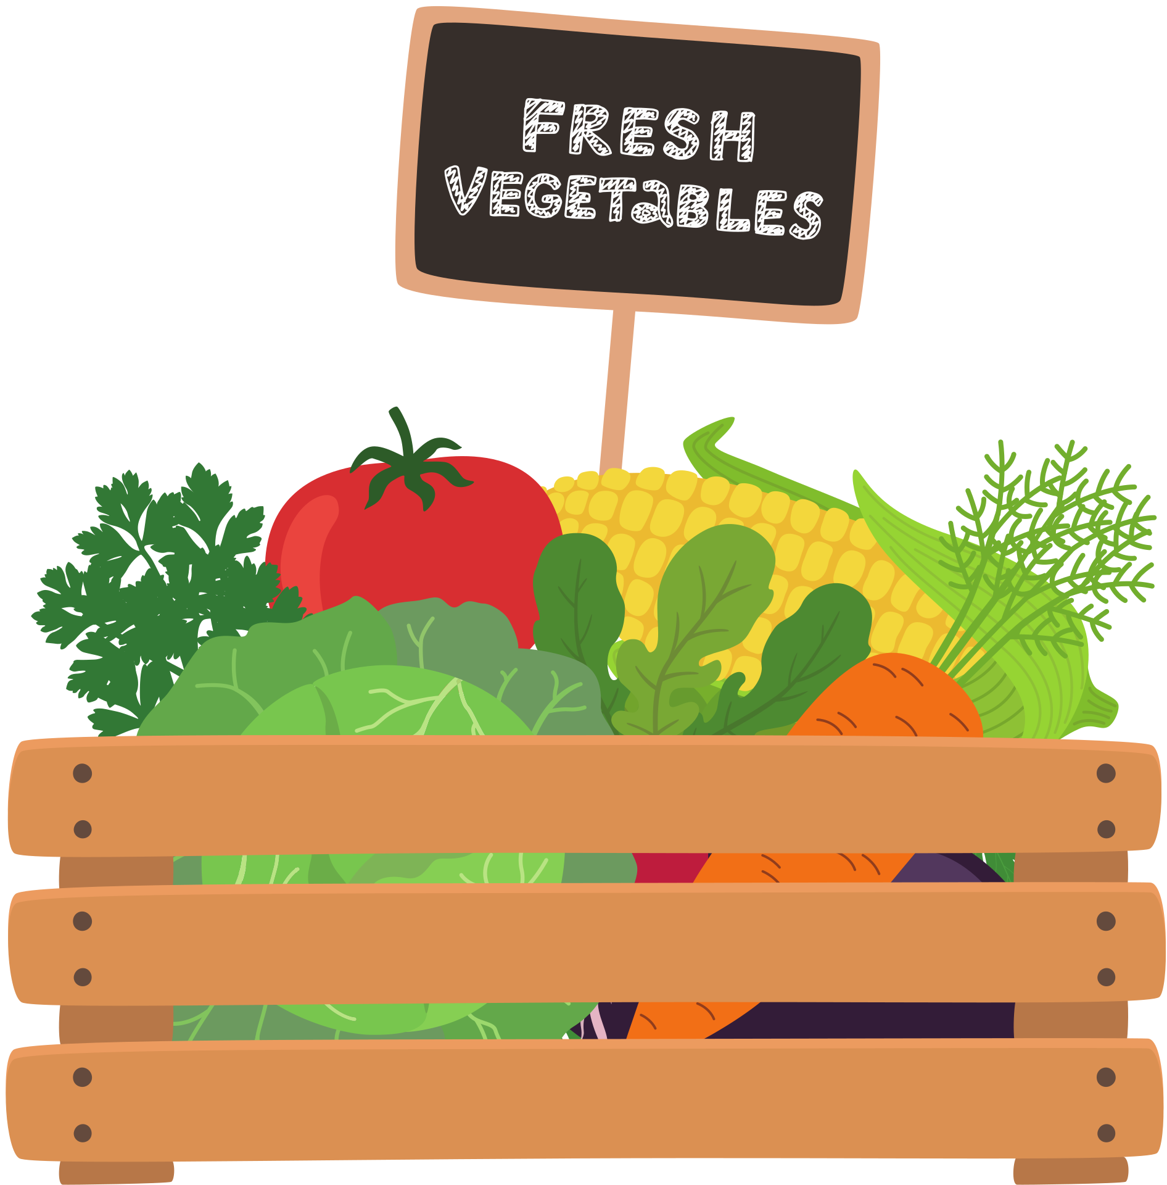




SUCCESS FACTORS
Customer Service
IOT Operations
Quality Products
1-Day
Delivery
Brand recognition
Companies that prioritize these success factors are better positioned to differentiate themselves in a crowded market and build a loyal customer base.

Slide 24

CONCLUSION
To make a successful vegetable quick commerce business,
It is essential to address the challenges faced by the industry, such as operational costs, delivery logistics, and competition from traditional markets.
Companies should focus on efficient delivery, high-quality products, technology-driven operations, customer service, and brand recognition to differentiate themselves and build a loyal customer base.
By prioritizing these success factors, vegetable quick commerce businesses can thrive in a competitive market and provide a convenient and reliable service to customers.

